Slide 1
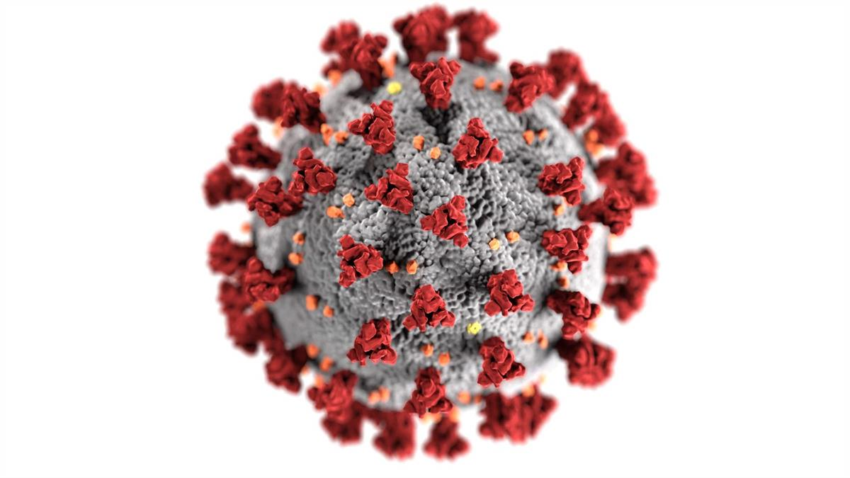
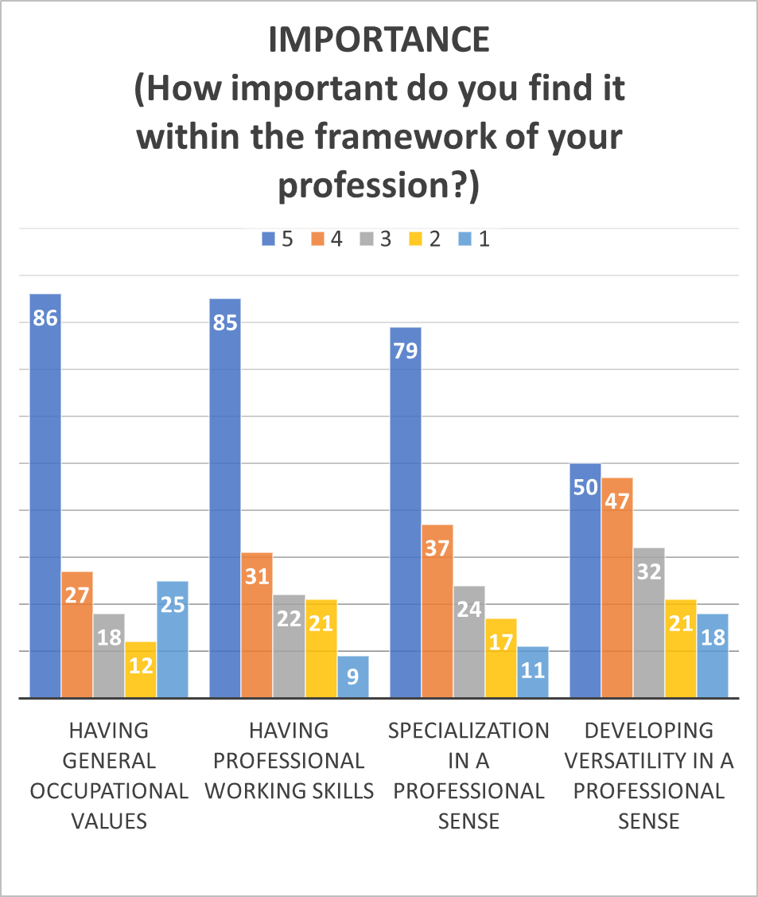
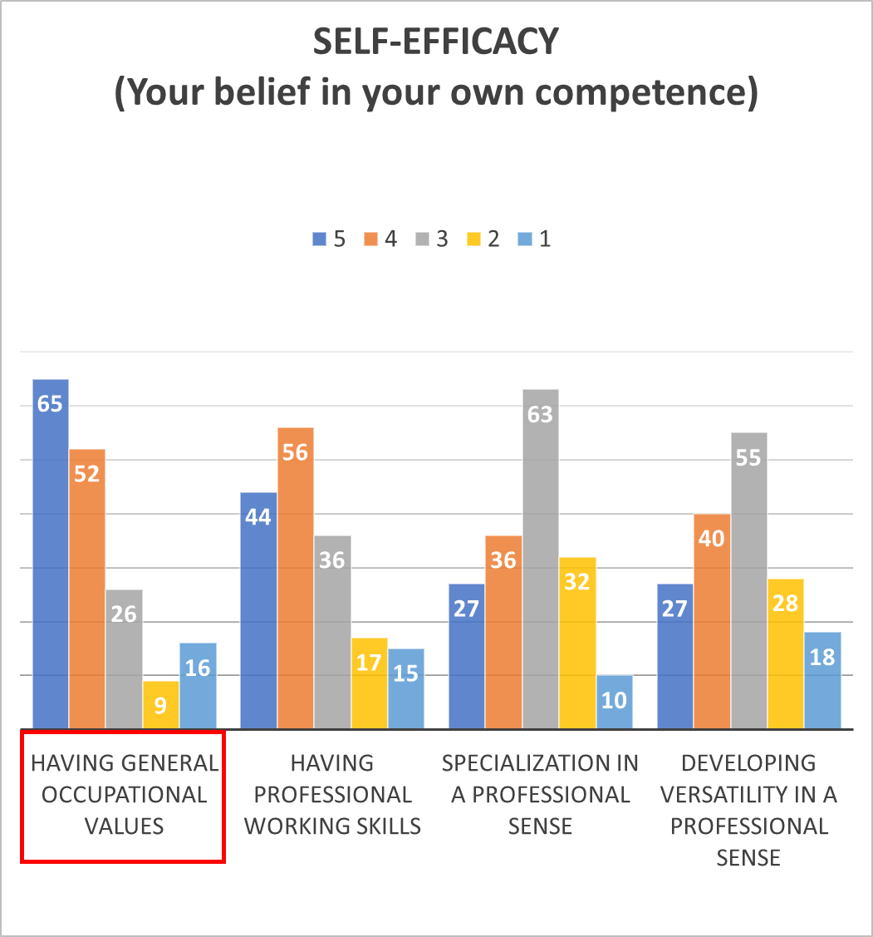
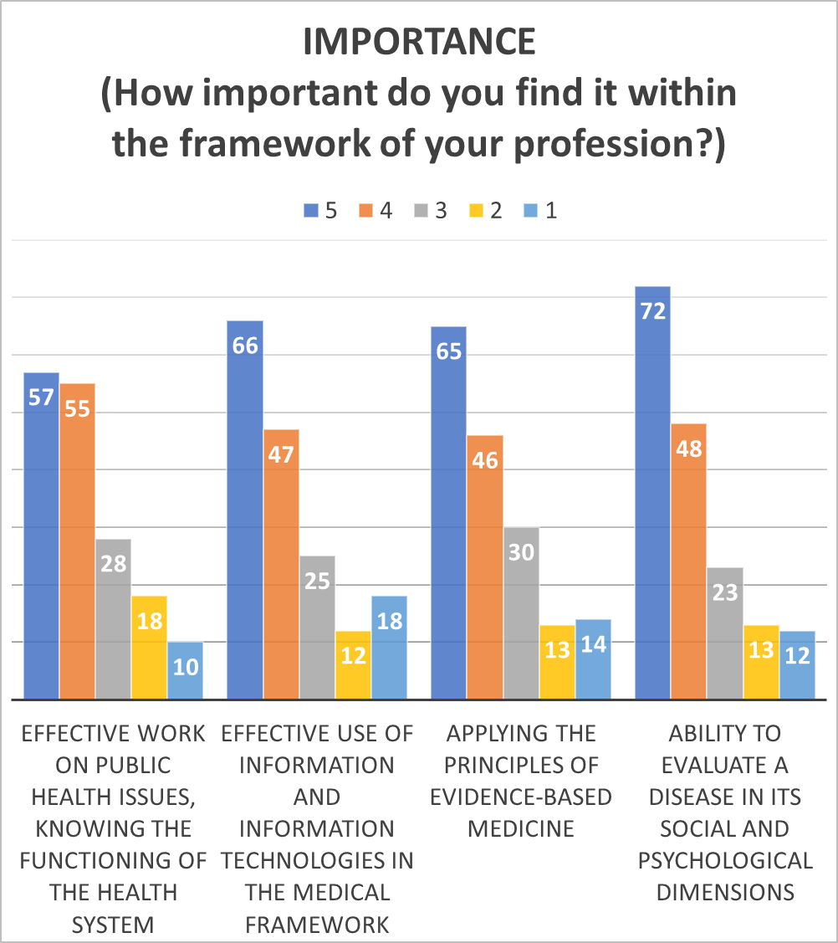
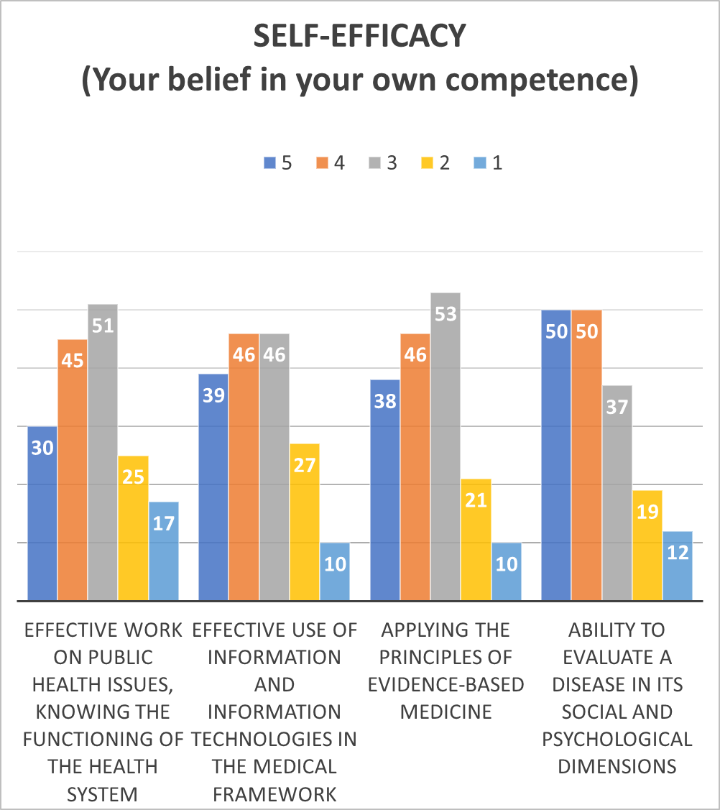
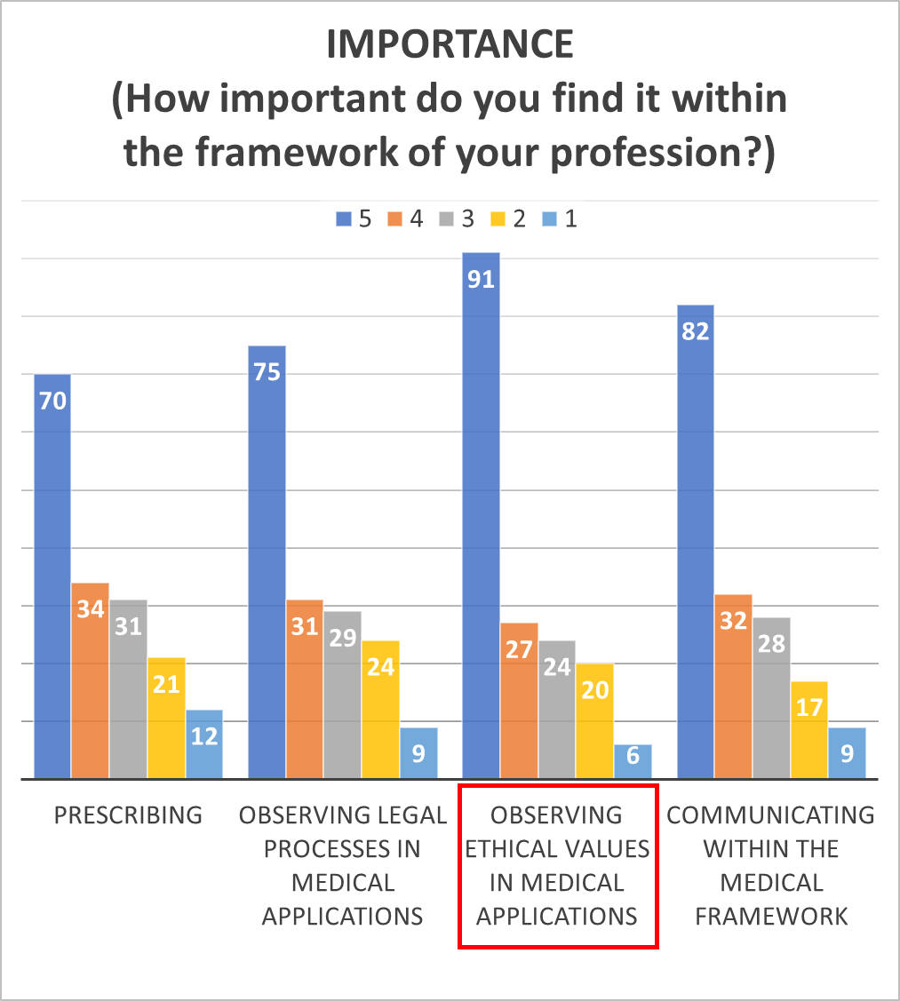
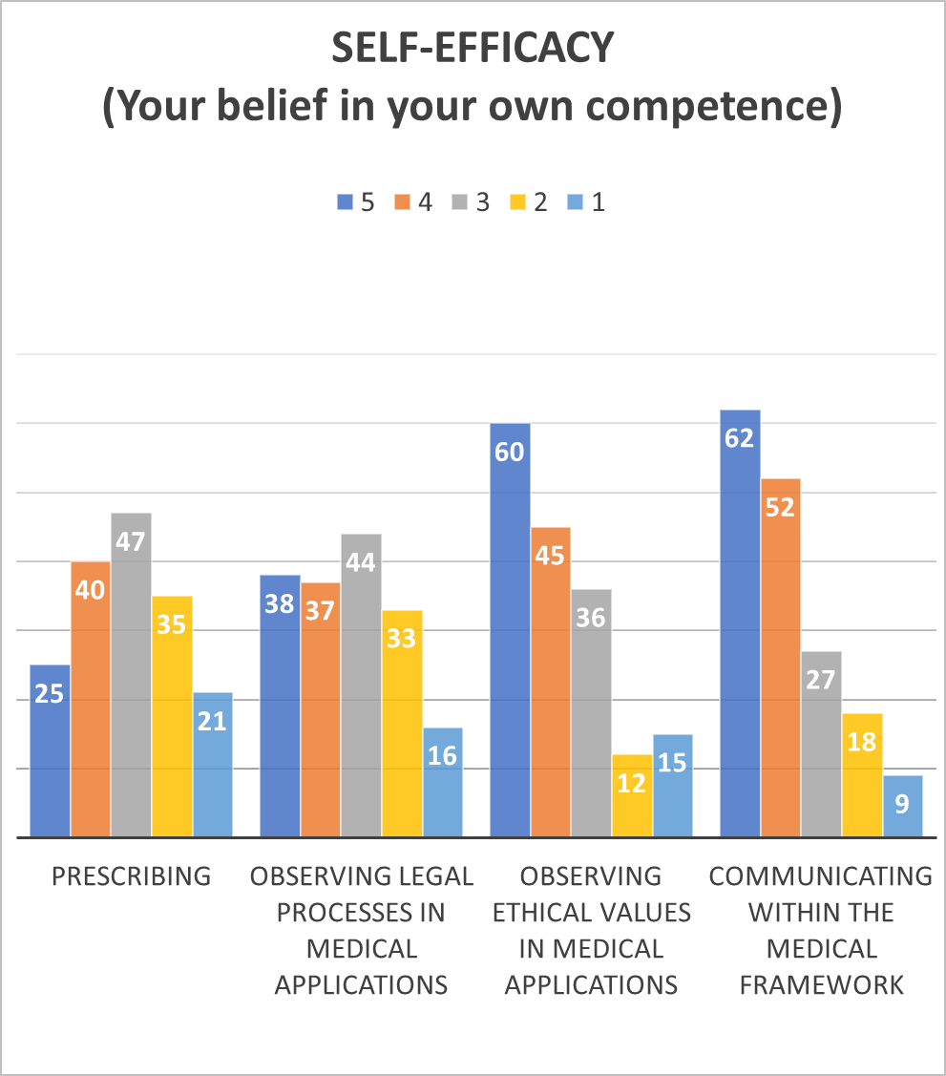
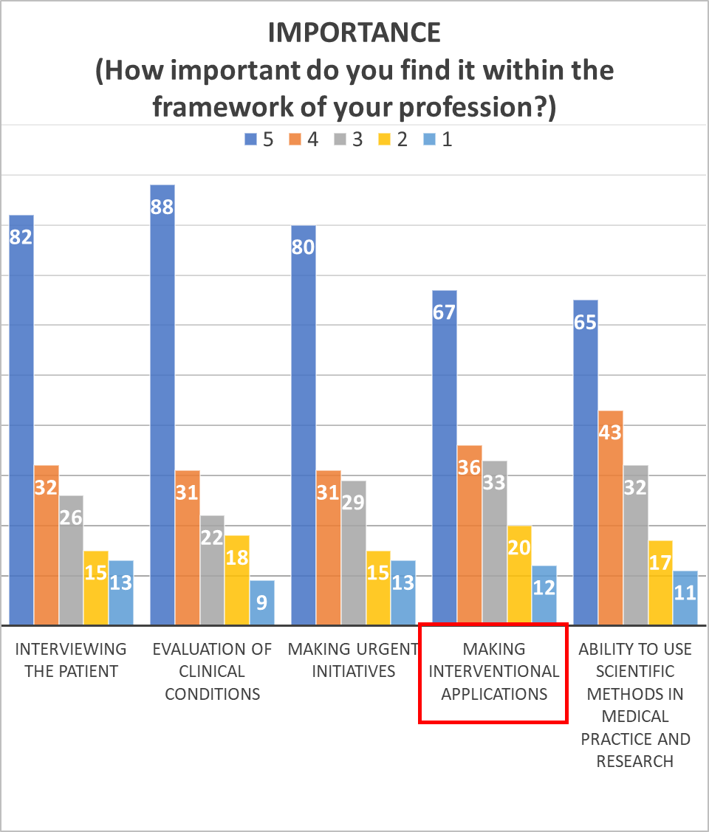
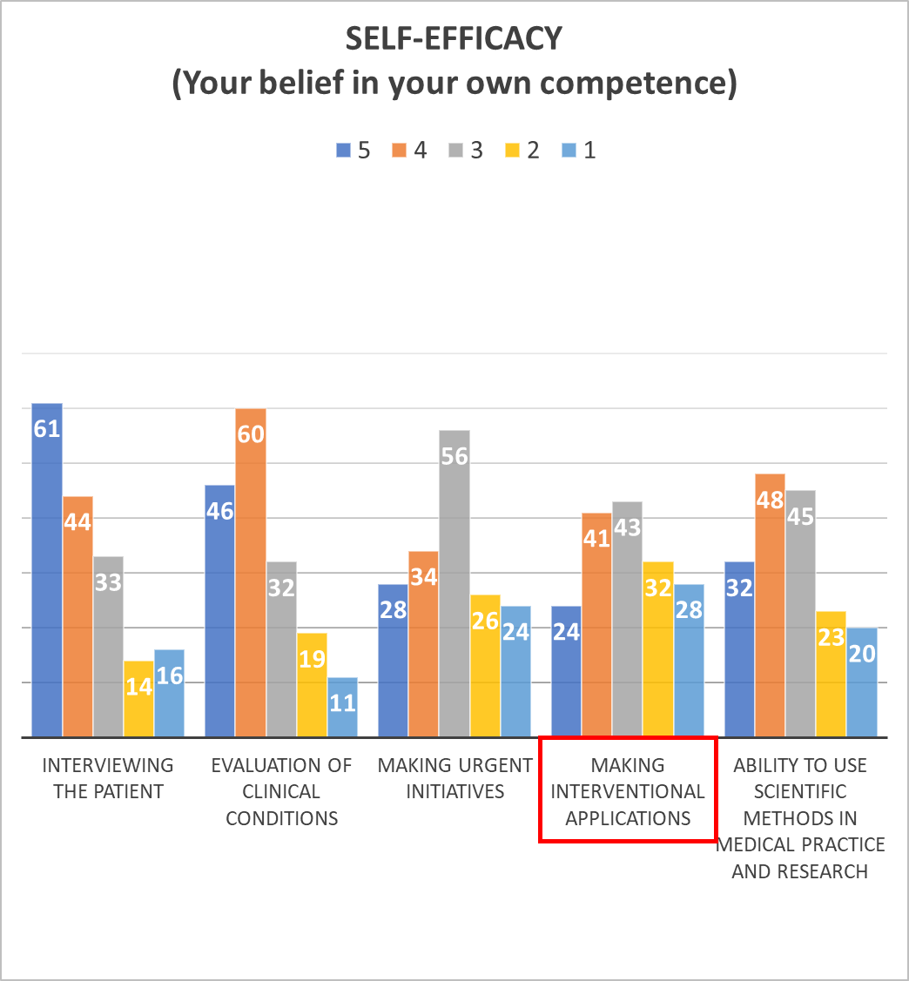
Self-efficacy Perceptions of 5th and 6th Grade Students in Bezmialem Vakif University Faculty of Medicine during the COVID-19 Outbreak
Hatice Yavaş¹, Semra Özçelik²
¹Bezmialem Vakif University Faculty of Medicine, Istanbul, Turkey
²Bezmialem Vakif University Faculty of Medicine, Department of Medical Education, Istanbul, Turkey
INTRODUCTION
In clinics, the perception of self-efficacy is emphasized as an important indicator of students' academic success and career planning. In the 2020-2021 academic period, internship practices were suspended for a while because of the COVID-19 pandemic. For this reason, it was considered worth investigating, especially the measurement of self-efficacy perceptions related to the professional competence of fifth and sixth grade students.
MATERIALS AND METHODS
“The Importance and Self-efficacy Perceptions of Physician Candidates regarding Occupational General Competencies Scale” was developed and used by Başusta and Elçin in 2014. In this study, it was prepared and applied through Google Forms. The information required to communicate with students provided by the permission of the dean's office. Descriptive statistics of the data is indicated as average n and %. All statistical analyses are analyzed and reported at 95% confidence level at alpha= 0.05 significance level in SPSS 21.0 program.
RESULTS
76 fifth-graders and 92 sixth-graders completed the study, with a participation rate of 84%. (%54 female, %45 male) When scale results are evaluated on a class basis, there is no statistically significant difference in professional importance and self-efficacy sub-scores. (p>0.05) Compared to the maximum scores, the self-efficacy level is both intermediate in the fifth and sixth grades. On the basis of gender, there is a statistically significant difference in importance. (p<0.05) Women gave more importance points than men. The self-efficacy scores given by women and men are close, with no significant difference. (p>0.05) The lowest mean of importance (3.75) and self-efficacy (3.0) are in the practice of interventional applications.
IMPORTANCE (How important do you find it within the framework of your profession?) Mean Scores |  | SELF-EFFICACY (Your belief in your own competence) Mean Scores
3,81 | Having general occupational values | 3,84
3,96 | Having professional working skills | 3,57
3,78 | Specialization in a professional sense | 3,22
3,78 | Developing versatility in a professional sense | 3,17
3,77 | Effective work on public health issues, knowing the functioning of the health system | 3,27
3,77 | Effective use of information and information technologies in the medical framework | 3,45
3,80 | Applying the principles of evidence-based medicine | 3,48
3,92 | Ability to evaluate a disease in its social and psychological dimensions | 3,63
3,76 | Prescribing | 3,07
3,82 | Observing legal processes in medical applications | 3,28
4,05 | Observing ethical values in medical applications | 3,73
3,95 | Communicating within the medical framework | 3,83
3,92 | Interviewing the patient | 3,71
4,01 | Evaluation of clinical conditions | 3,66
3,89 | Making urgent initiatives | 3,09
3,75 | Making interventional applications | 3,00
3,79 | Ability to use scientific methods in medical practice and research | 3,29
CONCLUSION
This study demonstrated that, for 5th and 6th graders the importance and self-efficacy levels are lowest in making interventional applications. There was no significant difference found between students in the name of self-efficacy. It was shown that women give more importance to clinical practices than men.
REFERENCES
1.Açıksöz S, Uzun Ş, Arslan F. Hemşirelik öğrencilerinde öz yeterlilik algısı ile klinik uygulamaya ilişkin kaygı ve stres durumu arasındaki ilişkinin incelenmesi. Gülhane Tıp Derg 2016;58:129-135
2. Yılmaz ND, Yalçınkaya M. Tıp Öğrencilerinin Öğrenme İklimi Algılarının; Akademik Öz yeterlik, Hekimlik Mesleğine Yönelik Tutum ve Akademik Başarı Açısından İncelenmesi. Tıp Eğitimi Dünyası, 2018;53:13-23
3. Başusta NB, Elçin M. Hekim Adaylarının mesleksel yeterliklerine ilişkin önem ve özyeterlik algıları ölçeğinin geliştirilmesi. Eğitim Bilimleri ve Uygulama, 2014;13 (26):239-255
4.Özçelik S, Küçük ÖS, Çakır E, Kazancıoğlu E. Medical Education in Epidemic and Disaster Situations. Bezmialem Science 2020; 8: 438-443

